Slide 1

DETECTING PHISHING WEBSITES USING MACHINE LEARNING
TEAM MEMBERS:
1.N.yashovardhan
college:
Chadalawada Ramanamma Engineering
Tirupati.

Slide 2
PHISHING ATTACKS

Slide 3
agenda
ABSTRACT
INTRODUCTION
TYPES
EXAMPLES
PREVENTION
DETECTION
CONCLUSION

Slide 4
INTRODUCTION
Phishing is the act of attempting to payoff information such as username, password and credit card details as a trustworthy entity in an electronic communication. Communication purporting to be from popular social websites, auction sites, online payments process or IT administrator is commonly used to lure the unsuspecting public.

Slide 5
LET’S GET STARTED

Slide 6
TYPES OF PHISHING ATTACK
DECEPTIVE PHISHING
SPEAR PHISHING
CLONE PHISHING
WHALING
LINK MANIPULATION
VOICE PHISHING

Slide 7
EXAMPLE OF PHISHING ATTACK
A spoofed email ostensibly from myuniversity.edu is mass-distributed to as many faculty members as possible.
The email claims that the user’s password is about to expire. Instructions are given to go to myuniversity.edu/renewal to renew their password within 24 hours.
The user is redirected to myuniversity.edurenewal.com, a bogus page appearing exactly like the real renewal page, where both new and existing passwords are requested.

Slide 8
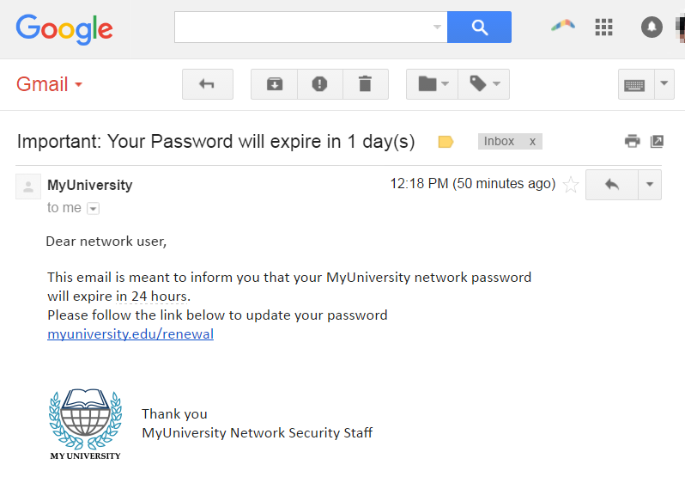
The user is sent to the actual password renewal page. However, while being redirected, a malicious script activates in the background to hijack the user’s session cookie. These results in a reflected XSS attack, giving the perpetrator privileged access to the university network.

Slide 9
PREVENTION OF PHISHING ATTACK
Guard against spam.
Communicate personal information only via phone or secure website.
Don’t click on links , download files or open attachments in emails from unknown sender.
Sound security policies.
Security awareness training.

Slide 10
Detection of phishing attacks
Use a custom DNS services.
Use your browser’s phishing list.
Use sites to check links.
Ue your own ninja skills.
Look for secure connections.

Slide 11
CONCLUSION
For Phishing attack, there are many ways to launch the attack. Here the research focuses on developing a detection and prevention techniques so that in future the client can take necessary actions to prevent phishing attacks. In this work, various types of attacks and their prevention and detection are studied. In future, focus is to compare various tools for phishing attack prevention.

Slide 12
THANKS!

Slide 13
ANY QUERIES?

